Slide 1
BIA 650
Process Innovation and Management
9 – ML Case Studies, Large Scale
Discriminant Analysis,
Cluster Analysis
Neural Net Demonstration
Large Scale Optimization
© E. A. Stohr, 2020
Notes:
Up to this point, we have been concerned with choosing & designing business processes.
In this lecture, we look at:
Simulation: How to check alternative process designs
WFMS: How to automate processes
Since not all processes can be expressed as fixed workflows, we also look at:
Groupware: How to support coordination in unstructured situations
Finally, we look at 2 real case studies involving the implementation of a WFMS

Slide 2
Statistics:Discriminant Analysis
Classify members of two or more groups. Find a weighted combination of the data for each member, called a discriminant score, and then classify the member into group 1 or group 2 depending on which side of a cutoff score the member’s discriminant score falls.
WSJ Subscribers Problem W&A Example 8.8
Using income and size of investment portfolio, determine a classification rule that maximizes the number of people correctly classified as subscribers or nonsubscribers.
Using appropriate weights, we create a discriminant score for each of 84 customers. Then based on a cutoff score, we classify each customer as a subscriber or nonsubscriber, and we tally the number of correct classifications.

Slide 3
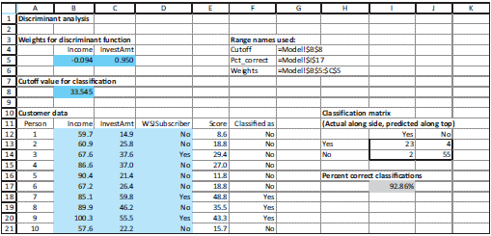
Discriminant Analysis
=SUMPRODUCT(Weights,B12:C12)
=IF(E12<Cutoff,”No”,”Yes”)
=COUNTIFFS($D$12:$D$95,$H13,$F$12:$F$95,I$12)
  =(I13+J14)/SUM(I13:J14).

Slide 4
Discriminant Results
Classification matrix – often called a “Confusion Matrix”
(Actual along side, predicted along top)
 | Yes | No
Yes | 23 | 4
No | 2 | 55
Percent correct classifications
 | 92.86%
For the training data, we achieve 93% accuracy.
We must test our discriminant function on a hold-out sample where it is unlikely to do as well.
Note: Using SolverTable, we could trace the sensitivity of the Accuracy to the cut-off.

Slide 5
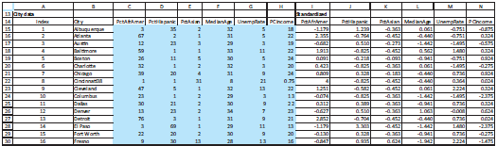
Statistics: Cluster Analysis
Objective: Find four cities to be used as cluster centers and to assign all other cities to one of these cluster centers.
Choose a city to center, each cluster.
Assign each city to the nearest cluster center, where nearest is defined in terms of the six demographic variables
Minimize the sum of the squared distances from each city to its cluster center.
Raw data
Standardized data

Slide 6
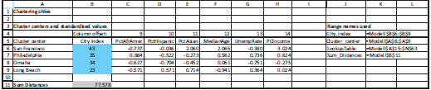
Cluster Model Solution
=VLOOKUP(B6,LookupTable,2
=VLOOKUP($B6,LookupTable,C$4)
Decision variables and objective cell
Trial City Centers (randomly chosen at start)
Objective: Min sum of distances from cluster center
=SUM(T15:T63)

Slide 7
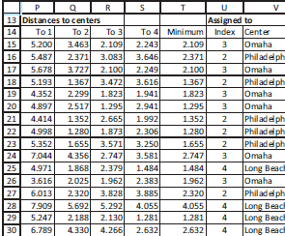
Distance Calculations
Euclidean Distance of each city to the trial cluster center (city):
=SUMXMY2($I15:$N15,$C$6:$H$6)
=MIN(P15:S15)
=MATCH(T15,P15:S15,0)
© E. A. Stohr, 2012

Slide 8
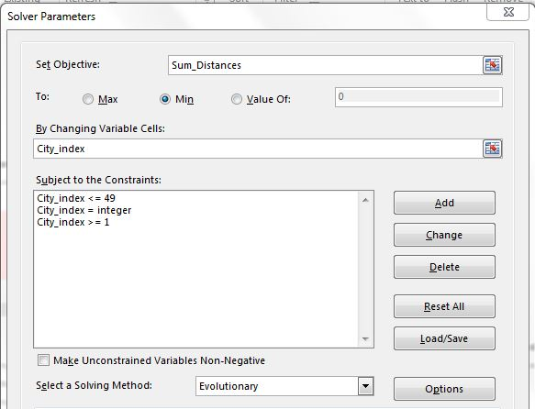
City Clusters - Solver

Slide 9
Neural Nets & Learning
Example: Optical Character Recognition (OCR)
Recognition of printed or hand-written characters and conversion to ASCII (Character format).
ASCII encoding of letter “A” appears on output layer
Output layer
Hidden layer
Input layer
Neurons
Synapses
Image pattern of letter “A” is encoded and transmitted to input layer
DEMO: https://kaltura.stevens.edu/media/NN+Demo/1_vks70kfk

Slide 10
Neural Nets & Learning
A Neural Net (an artificial intelligence (AI) software program) simulates the brain. The brain consists of billions of interconnected nerve cells called “neurons.” A neuron that is sufficiently excited by a stimulus reacts by “firing” chemicals that travel along “synapses” to other neurons. Neural nets can be trained to recognize complex patterns. Neural nets often outperform statistical techniques.
Applications: OCR, voice recognition, stock market trading models, market research.
Examples: Beer and pampers, tank recognition
Demonstration of a simple NN: https://kaltura.stevens.edu/media/NN+Demo/1_vks70kfk

Slide 11
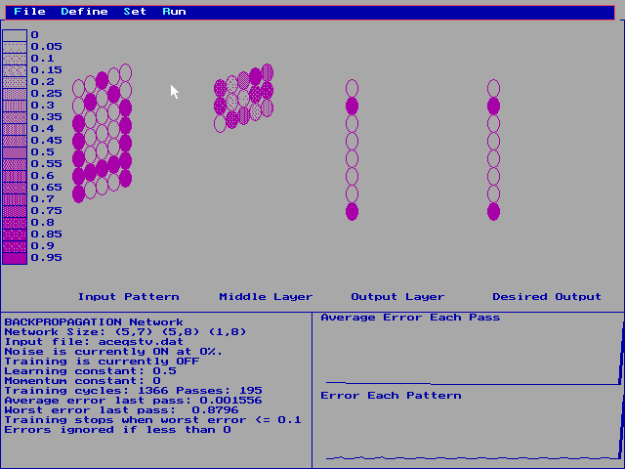
Learning the Alphabet
The connections between the input layer and output layer are strengthened or weakened by repeated exposure to an input pattern of the letter “A” until the output layer “learns” to show the ASCII encoding of “A”.
Input Layer
Hidden Layer
Output Layer
Training Set
ASCII Representation of the letter “A”
Because the output is the same as the training set value, the net has been trained to recognize the letter “A”

Slide 12
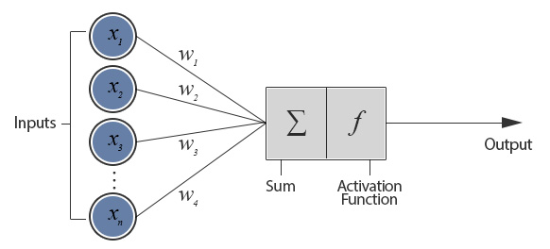
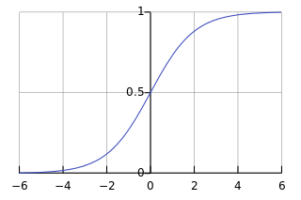
A Neuron
Input to neuron, j = Net_{j} = ∑ w_{jii}I_{i}
f = Output from neuron, j = 1/(1 + e ^{–Netj + µj} )
Sigmoid function

Slide 13
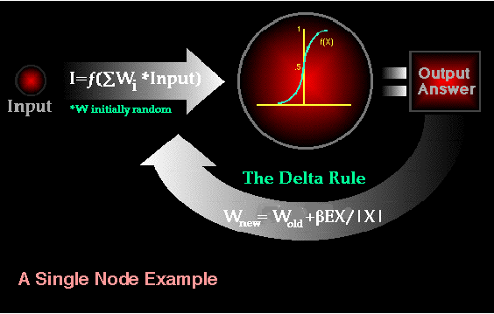
ANN & Backpropagation
A number of patters, p, are presented to the network during an “epoch”
At the output layer:
o_{pj} - output at output neuron, j
t_{pj} - target at output neuron, j
Error at the output layer:
E= ½ ∑∑ (t_{pj}-o_{pj})
^{p j}
The method of steepest descent is used to optimally adjust the weights at the output and then the adjusted weights are propagated back through the network.
http://pages.cs.wisc.edu/~bolo/shipyard/neural/local.html

Slide 14
What is Data, Info, and K?
Data
  a state, often described with bits and bytes
Information
  “data endowed with relevance and purpose” (Drucker) …
  explicit K used to organize data… message (Davenport)
  function of context (e.g., business process)
Knowledge
  tacit and explicit; and many other categories...
  tacit - framed experiences
    technical dimension - skill-like know how
    cognitive dimension - mental models that embody our values and beliefs, and that filter perception

Slide 15
A Management Perspective
Knowledge is characterized by the following dimensions (metaphors):
Stocks
(Objects -→ IT)
Flows
(Processes -→ HR
Action -→ People
K-capability

Slide 16
A Metaphor For Understanding K
neural net
An action-oriented view of knowledge
database
Knowledge is a person’s ability to make a decision (neural net) based on past experience (database or memory.)

Slide 17
A Metaphor For Understanding K
Medical Expert
Young Intern
Symptoms
Diagnosis
Learning Cycle
Both the Intern’s Neural Net and Database of Experience are Updated

Slide 18
Large Scale Optimization
Introduction to tools
Simple Production Problem
  Arrays
  Data Declarations
  Generalized Problem
© E. A. Stohr, 2018
Notes:
This course is about designing organizations and processes.
Processes are the means through which work gets done. (Good people can’t overcome poor processes (Peter Keen)
Often the design approach will involve the use of IT. But people are just as important. We will try to take a balanced view.
How do we know if an organization is more efficient? More effective?
(Both efficiency & effectiveness are important, but many “efficient” organizations are now out of business.
In this lecture, we concentrate on how we can measure the efficiency (productivity) of organizations and processes. Unless we can measure improvement, we can not tell if our design intervention has been useful.
Three approaches to answering this question:
Economist’s - Data Envelopment Analysis
Accountant’s - Activity-based Costing (ABC)
Financial - ROI and Economic Value added (EVA)

Slide 19
IBM ILOG OPL Components
OPL Optimization Programming Language: A simple modeling language for optimization
CPLEX: A powerful solver for large-scale LP/IP, MIP, etc.
CPLEX Studio IDE*: User-friendly interface for the CPLEX solver. Edit models, display results, and so on.
Software is free for students:
https://www.ibm.com/account/reg/us-en/signup?formid=urx-20028
* IDE – Integrated Development Environment

Slide 20
Simple Example
Consider a Belgian company Volsay, which specializes in producing ammoniac gas (NH3) and ammonium chloride (NH4Cl). Volsay has at its disposal 50 units of nitrogen (N), 180 units of hydrogen (H), and 40 units of chlorine (Cl). The company makes a profit of 40 Euros for each sale of an ammoniac gas unit and 50 Euros for each sale of an ammonium chloride unit. Volsay would like a production plan maximizing its profits given its available stocks.
The OPL statement shown below formalizes this problem.
Source: https://www.ibm.com/support/knowledgecenter/SSSA5P_12.6.1/ilog.odms.ide.help/OPL_Studio/opllanguser/topics/opl_languser_shortTour_LP_elements.html

Slide 21
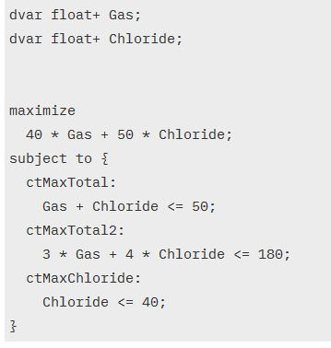
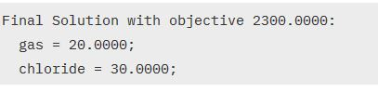
Volsay Production Problem (ctd.)

Slide 22
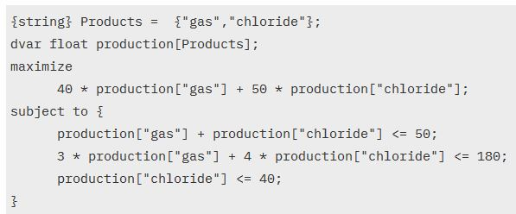
Volsay: Using Arrays

Slide 23
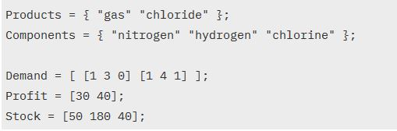
VOLSAY: Data Declarations

Slide 24
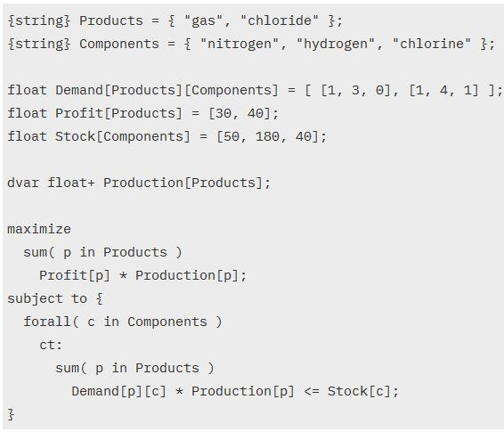
Volsay: Generalized Model

